Slide 1



Fundamental Concepts, CNN and Embeddings
Dr. Sabyasachi Mukhopadhyay
Teaching Fellow, Dept. of CSE
IIT Kharagpur
1

Slide 2
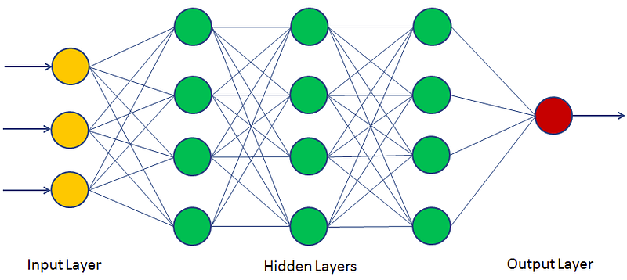
Backpropagation — How Neural Networks Learn
Forward Pass: Input flows through network → produces prediction ŷ
Loss Function: Measure error between ŷ and true label y
  MSE for regression: L = (1/n)Σ(yᵢ - ŷᵢ)²
  Cross-entropy for classification: L = −Σ yᵢ log(ŷᵢ)
Backward Pass: Compute gradient of loss w.r.t. each weight using chain rule
  ∂L/∂w = ∂L/∂ŷ · ∂ŷ/∂z · ∂z/∂w (chain rule, layer by layer)
Gradient Descent Update: w ← w − η · ∂L/∂w (η = learning rate)
Key challenges: Vanishing gradients (deep nets), overfitting, local minima
2

Slide 3
What We'll Cover
Six core building blocks behind training a neural network
01 Backpropagation
02 Loss Function
03 Parameter vs Hyperparameter
Chain rule flows error backward through the network to update every weight.
Measures how wrong the model's predictions are — training minimises this.
Parameters are learned from data; hyperparameters are set before training begins.
chain rule
gradient descent
MSE
Cross-entropy
weights, bias
lr, epochs
∂L/∂w = ∂L/∂ŷ · ∂ŷ/∂w
L = −Σ yᵢ log(ŷᵢ)
params: w, b vs lr, batch size
04 Train / Test / Validation
05 Overfitting / Underfitting
06 Regularization
Data is split to fit the model, tune it, and fairly judge it on unseen examples.
Overfitting memorises training data; underfitting fails to capture the pattern at all.
Techniques that constrain the model to curb overfitting and improve generalisation.
train set
val / test set
high variance
high bias
L1 / L2
Dropout
typical split ≈ 70 / 15 / 15
watch the train–validation loss gap
L_reg = L + λ Σ w²
3

Slide 4
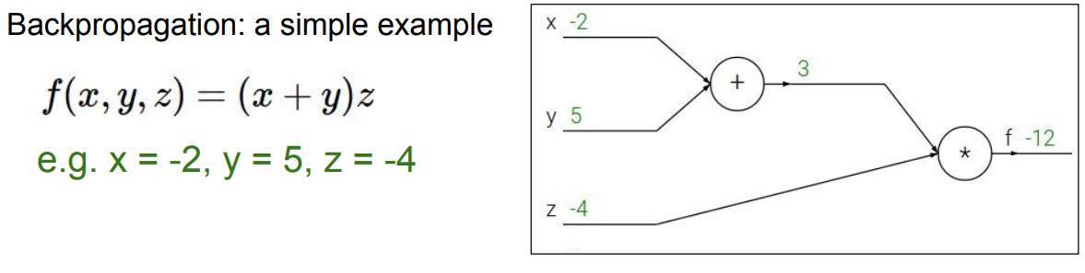
Backpropagation — How Neural Networks Learn
Slides taken from “CS231n: Deep Learning for Computer Vision Stanford”
4

Slide 5
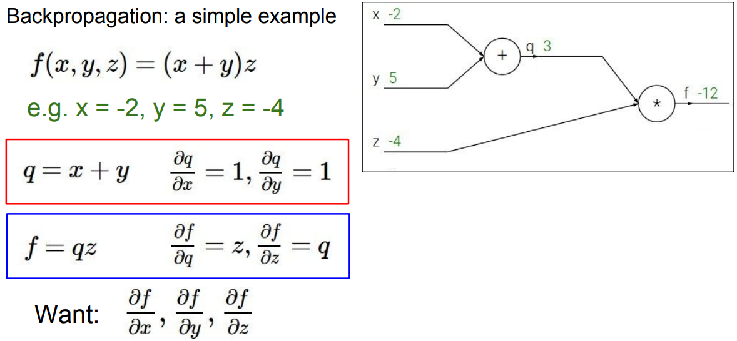
Backpropagation — How Neural Networks Learn
Slides taken from “CS231n: Deep Learning for Computer Vision Stanford”
5

Slide 6
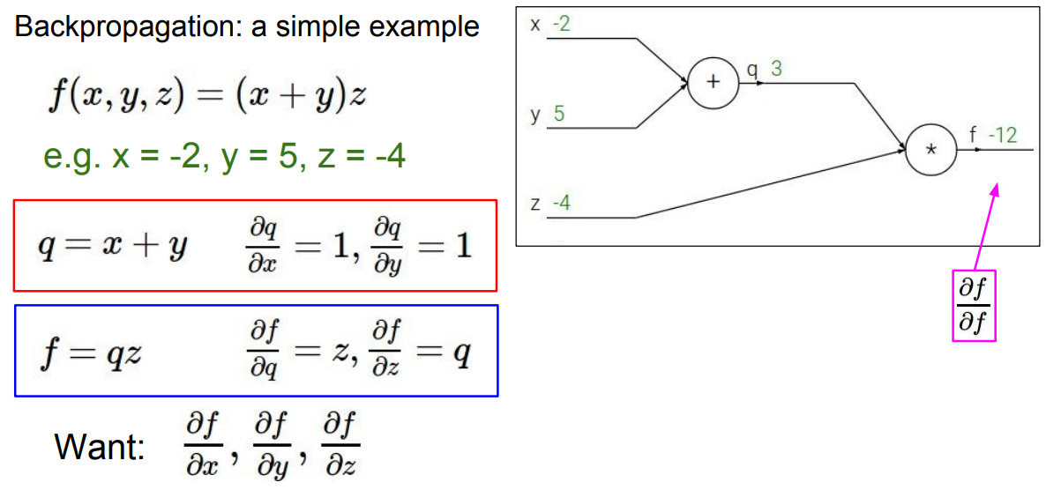
Backpropagation — How Neural Networks Learn
Slides taken from “CS231n: Deep Learning for Computer Vision Stanford”
6

Slide 7
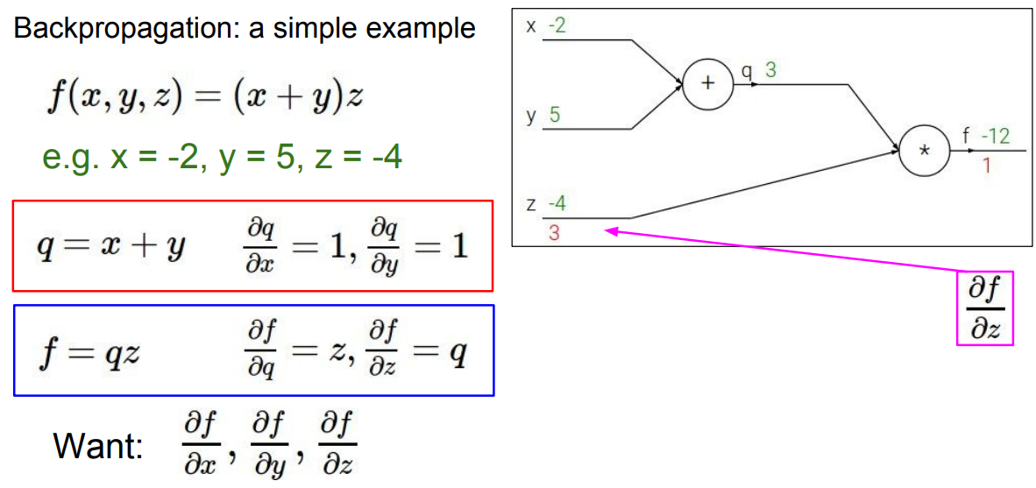
Backpropagation — How Neural Networks Learn
Slides taken from “CS231n: Deep Learning for Computer Vision Stanford”
7

Slide 8
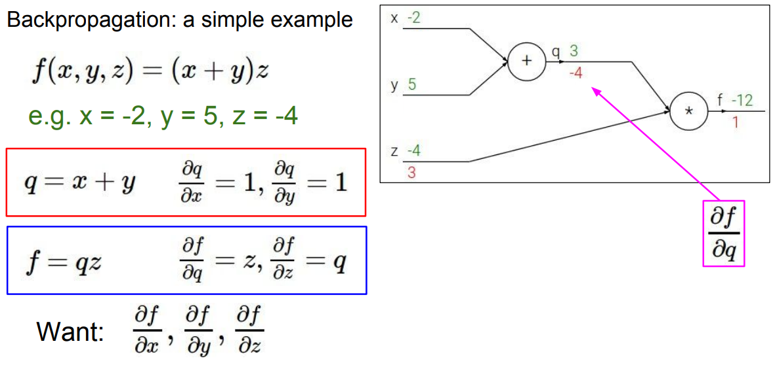
Backpropagation — How Neural Networks Learn
Slides taken from “CS231n: Deep Learning for Computer Vision Stanford”
8

Slide 9
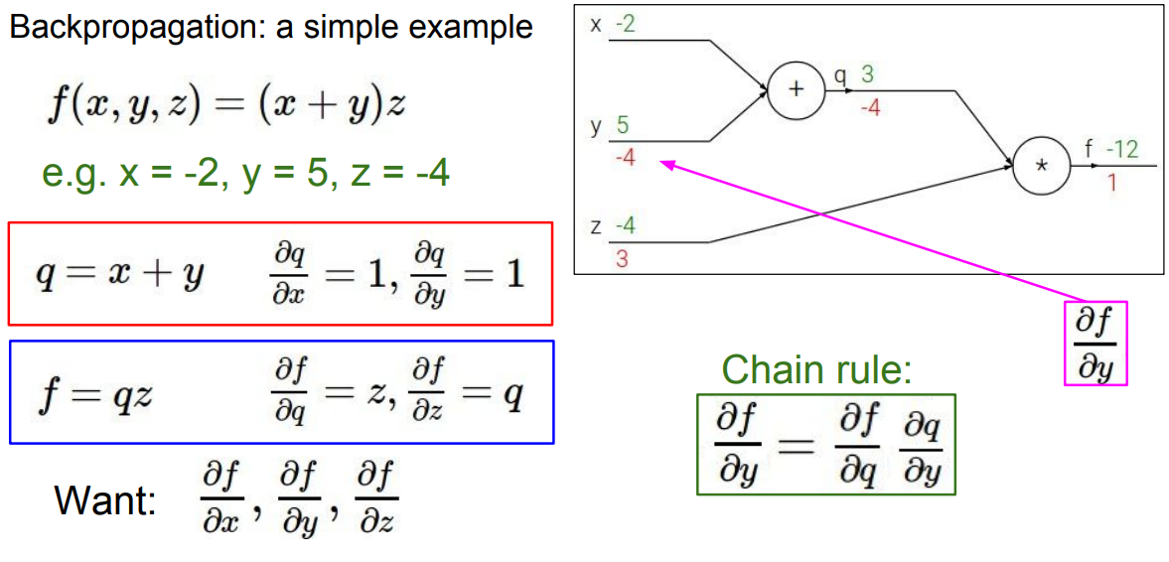
Backpropagation — How Neural Networks Learn
Slides taken from “CS231n: Deep Learning for Computer Vision Stanford”
9

Slide 10
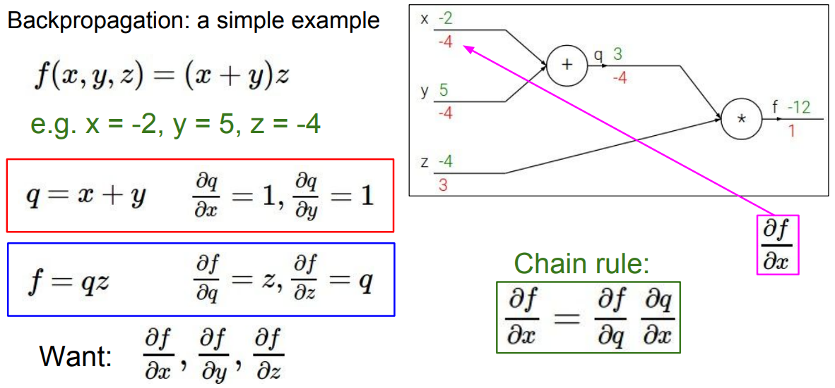
Backpropagation — How Neural Networks Learn
Slides taken from “CS231n: Deep Learning for Computer Vision Stanford”
10

Slide 11
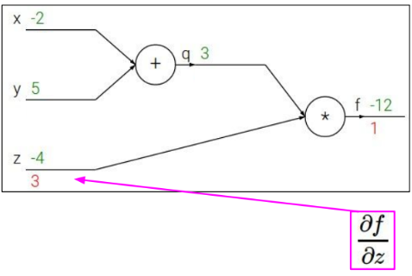


Backpropagation — How Neural Networks Learn
If we consider the weight z and learning rate as 0.1, then the updated value of z,
💡 Key Insight: The weight z is nudged slightly opposite to the gradient, reducing the loss with each step.
Slides taken from “CS231n: Deep Learning for Computer Vision Stanford”
11

Slide 12
What is a Loss Function?
What is a Loss Function?
Definition
Training Loop
A loss function (cost function) measures how far the model's predictions are from the true labels.
The optimizer uses the loss to update model parameters via backpropagation — lower loss means better predictions.
1. Forward pass → get ŷ
2. Compute loss: L(y, ŷ)
3. Backprop gradients
4. Update weights (optimizer)
5. Repeat until loss ↓
Choose your loss function based on the task:
Regression
Binary Classification
Multi-class
→ MSE
→ Binary Cross-Entropy
→ Categorical Cross-Entropy
Continuous output
e.g. house price
2-class output
e.g. spam / not spam
3+ classes
e.g. cat / dog / bird
12

Slide 13
Loss Function 1 — Mean Squared Error (MSE)
Mean Squared Error — Regression Tasks
Intuition
MSE = (1/n) × Σ (yᵢ − ŷᵢ)²
Imagine you're predicting house prices:
Actual (y)
Predicted (ŷ)
Error²
Where:
yᵢ = actual (true) value
300K
280K
400M
ŷᵢ = predicted value
450K
460K
100M
n = number of samples
200K
250K
2500M
Σ = sum over all samples
MSE = (400M + 100M + 2500M) / 3
≈ 1,000M (penalises the 50K miss most!)
Key Properties
• Penalises large errors more heavily (squared)
• Always non-negative; perfect fit → MSE = 0
✔ Use when: output is a continuous
number (regression problems)
• Differentiable → works well with gradient descent
13

Slide 14
Loss Function 2 — Binary Cross-Entropy (BCE)
Binary Cross-Entropy — 2-Class Classification
Intuition
BCE = −(1/n) × Σ [yᵢ log(ŷᵢ) + (1−yᵢ) log(1−ŷᵢ)]
Spam classifier example:
Correct & Confident
Where:
True label: Spam (y=1)
Predicted: 0.95
Loss: Very low ≈ 0.05
yᵢ = true label (0 or 1)
ŷᵢ = predicted probability (0 to 1)
log = natural logarithm
Wrong & Confident
Key Properties
True label: Spam (y=1)
Predicted: 0.05
Loss: Very HIGH ≈ 3.0
• Uses log to heavily penalise confident wrong predictions
• Output layer uses Sigmoid (squashes output to 0–1)
BCE punishes confident mistakes far more than timid ones — this drives the model to be both accurate AND calibrated.
• Perfect predictions → BCE = 0
• Sensitive to class imbalance
✔ Use when: binary outcome — spam/not spam, fraud/not fraud, malignant/benign
14

Slide 15
Loss Function 3 — Categorical Cross-Entropy (CCE)
Categorical Cross-Entropy — Multi-Class Tasks
Intuition
CCE = −(1/n) × Σᵢ Σc yᵢc · log(ŷᵢc)
Image classifier: Cat / Dog / Bird
Class
Softmax ŷ
True y
Where:
Cat 🐱
0.70
1
yᵢc = 1 if sample i belongs to class c, else 0
Dog 🐶
0.20
0
ŷᵢc = predicted probability for class c
C = total number of classes
Bird 🐦
0.10
0
Σc = sum over all classes
Loss = −log(0.70) ≈ 0.36
Key Properties
Only the probability of the TRUE class (Cat) matters. Higher confidence in the correct class → lower loss.
• Generalisation of BCE to K > 2 classes
• Output layer uses Softmax (all probs sum to 1)
• Only the log of the true class probability contributes
✔ Use when: 3+ mutually exclusive
classes (one label per sample)
15

Slide 16
Comparing the Three Loss Functions
MSE
Binary Cross-Entropy
Categorical Cross-Entropy
(1/n)Σ(y−ŷ)²
−[y log(ŷ)+(1−y)log(1−ŷ)]
−Σc y_c · log(ŷ_c)
Task:
Task:
Task:
Regression
Binary Classification
Multi-Class Classification
Output:
Output:
Output:
Continuous number
Probability (0–1)
Prob. per class (sums to 1)
Activation:
Activation:
Activation:
None / Linear
Sigmoid
Softmax
Example:
Example:
Example:
House price, temperature, stock value
Spam detection, fraud, disease
MNIST digits, image classification
Penalty:
Penalty:
Penalty:
Squares the error — large errors hurt more
log penalises confident mistakes heavily
Only true-class probability matters
16

Slide 17

Quiz 1
You are building a model to classify images into 5 categories (cat, dog, bird, horse, fish). Which loss function should you use?
A) Mean Squared Error (MSE)
B) Binary Cross-Entropy
C) Categorical Cross-Entropy
D) Mean Absolute Error (MAE)
17

Slide 18
Quiz 1
You are building a model to classify images into 5 categories (cat, dog, bird, horse, fish). Which loss function should you use?
A) Mean Squared Error (MSE)
B) Binary Cross-Entropy
C) Categorical Cross-Entropy ✅
D) Mean Absolute Error (MAE)
18

Slide 19
Train / Validation / Test Sets
Why splitting your data correctly matters
Training Set 80%
Val 10%
Test 10%
🏋️
🔧
📊
Training Set
Validation Set
Test Set
Model learns weights & patterns
Largest split (~60–80%)
Directly used in backpropagation
More data → better generalization
Tune hyperparameters & architecture
Monitor val loss to stop early
Guides model selection decisions
Not used in gradient updates
Final unbiased performance estimate
Used ONLY once — at the very end
Never drives any design choice
Reports real-world generalisation
⚠ Memorizing train data = overfitting
⚠ Leaking val labels biases selection
⚠ Peeking at test = data leakage!
Key Rule: Each split must remain independent. Never let information from validation or test sets influence training decisions.
19

Slide 20
Underfitting, Good Fit & Overfitting
Underfitting
Good Fit
Overfitting
Model is too simple — fails to capture data patterns.
Model learns patterns well and generalizes to new data.
Model memorizes training data — fails on unseen data.
High training error
High test/validation error
Model ignores key trends
Low training error
Low test/validation error
Balanced complexity
Very low training error
High test/validation error
Fits noise, not signal
Cause: Too simple model / too little training
Cause: Right model + right training data
Cause: Too complex model / too little data
Fix: More layers, more features, train longer
Fix: This is the goal!
Fix: Regularization, dropout, more data
20

Slide 21
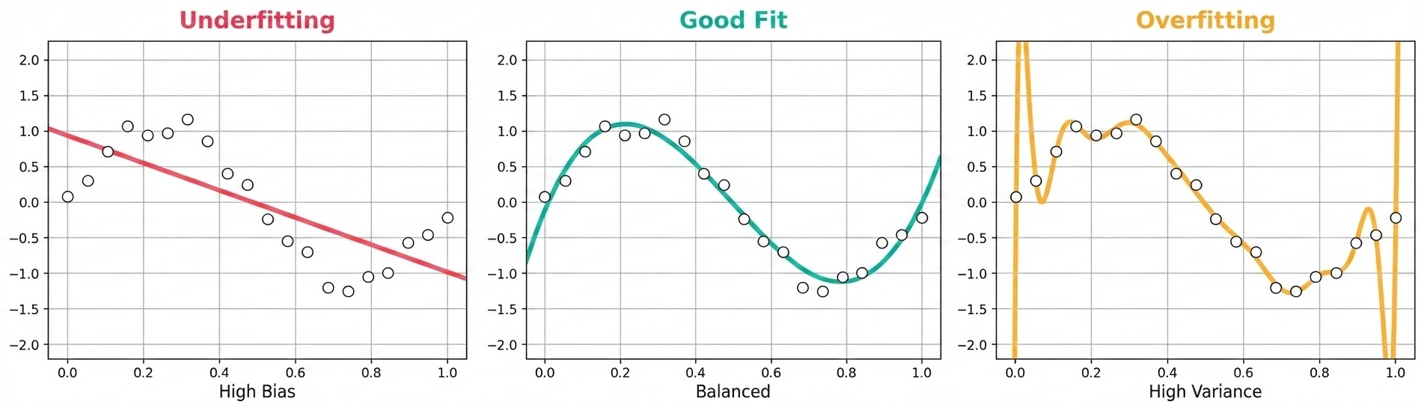
What Are Overfitting & Underfitting?
Underfitting
Good Fit
Overfitting
Model too simple — misses patterns in training data. High bias, low variance. Degree-1 poly on curved data.
Captures the true pattern without memorising noise. Low bias + low variance. The goal of every model.
Model too complex — memorises noise. Low train error, high val error. High variance, low bias.
21

Slide 22
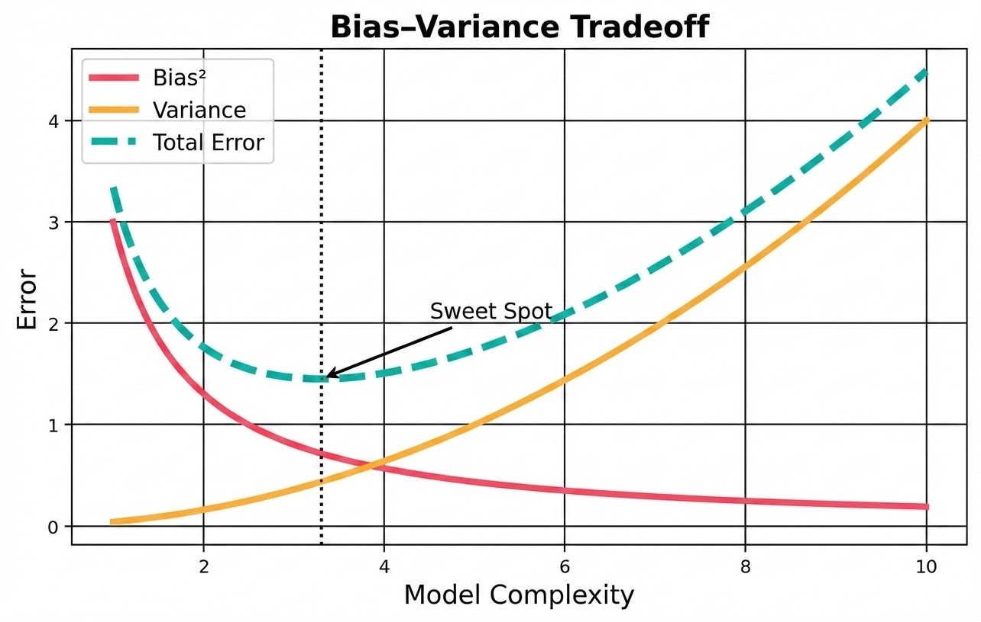
The Bias–Variance Tradeoff
High Bias
Underfitting. Model assumptions too rigid. Increases training error.
High Variance
Overfitting. Model too sensitive to training data. Val error diverges.
Sweet Spot
Minimise total error = Bias² + Variance + irreducible noise.
Total Error = Bias² + Variance + ε
22

Slide 23
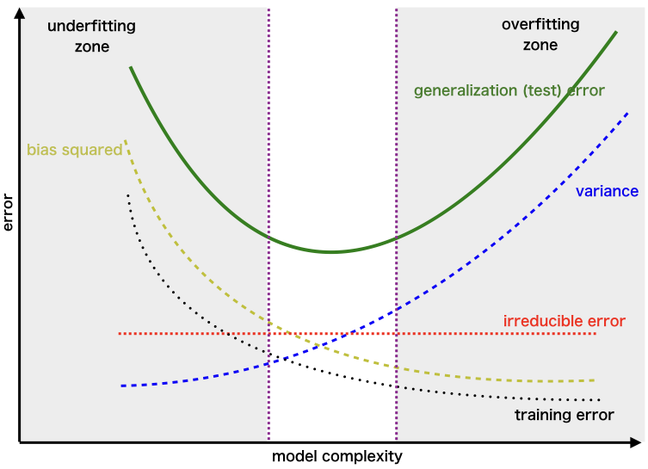
Overfitting, Underfitting & Regularization
Bias-Variance Tradeoff
Regularization Techniques
Underfitting (High Bias): Model too simple, cannot capture patterns
Overfitting (High Variance): Model memorizes training data, fails on new data
The sweet spot: Generalizes well to unseen data
Monitored via Train/Validation/Test split
Training accuracy vs Validation accuracy gap = overfitting signal
L2 Regularization (Weight Decay): Penalize large weights in loss function
L1 Regularization: Induces sparsity (feature selection)
Dropout: Randomly zero out neurons during training (prevents co-adaptation)
Batch Normalization: Normalize layer activations for stable training
Data Augmentation: Expand training set with transforms (flip, crop, noise)
Early Stopping: Stop training when validation loss starts increasing
23

Slide 24
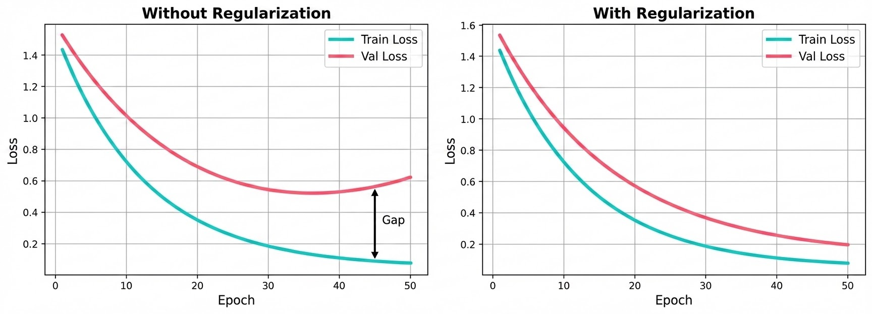
Detecting Overfitting — Training vs Validation Loss
Train loss ↓ but val loss ↑ → overfitting. Stop training early or add regularization.
With regularization, val loss tracks train loss — the gap shrinks significantly.
Both losses staying high → underfitting. Increase model capacity or train longer.
24

Slide 25
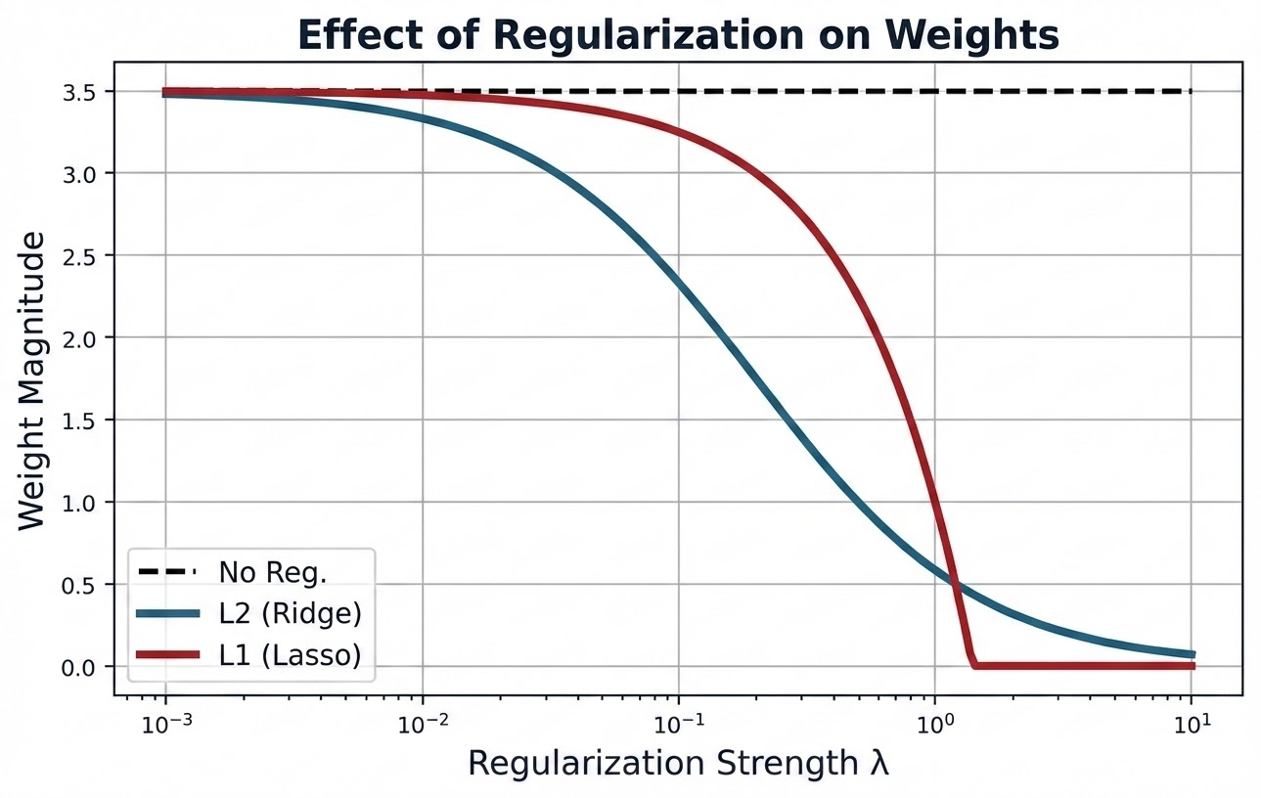
Regularization — Penalise Complexity
What is Regularization?
Adds a penalty term to the loss function to discourage large weights. Forces the model to stay simple and generalize better.
L2 (Ridge)
Loss + λ·Σw² Shrinks all weights smoothly toward zero.
L1 (Lasso)
Loss + λ·Σ|w| Drives some weights exactly to zero (feature selection).
# Sklearn: Ridge (L2) & Lasso (L1)
from sklearn.linear_model import Ridge, Lasso
ridge = Ridge(alpha=1.0) # alpha = λ
ridge.fit(X_train, y_train)
lasso = Lasso(alpha=0.1)
lasso.fit(X_train, y_train)
25

Slide 26
L1 vs L2 — Geometry & Sparsity
L1 — Lasso
L2 — Ridge
Constraint: diamond shape
Constraint: circle shape
Penalty: λ · Σ|wᵢ|
Creates sparse models (weights → 0)
Good for feature selection
Non-differentiable at 0
Solver: coordinate descent
Penalty: λ · Σwᵢ²
Shrinks all weights uniformly
No exact zeros — keeps all features
Differentiable everywhere
Has analytical closed-form solution
# L1 pushes weights to zero
lasso = Lasso(alpha=0.5)
print(lasso.coef_)
# → [0. 1.23 0. 0. 0.87]
# L2 shrinks weights evenly
ridge = Ridge(alpha=1.0)
print(ridge.coef_)
# → [0.12 0.88 0.03 0.21 0.75]
26

Slide 27
More Regularization Techniques — Dropout & Early Stopping
Dropout
Early Stopping
Randomly zero-out neurons during training (rate p). Forces network to learn redundant representations and prevents co-adaptation.
Monitor validation loss. Stop training when it stops improving (patience window). Keeps the best checkpoint automatically.
import torch.nn as nn
model = nn.Sequential(
nn.Linear(128, 64), # 128 in → 64 out
nn.ReLU(), # activation
nn.Dropout(p=0.5), # 50% dropout
nn.Linear(64, 10) # 64 in → 10 out
)
from tensorflow.keras.callbacks import EarlyStopping
cb = EarlyStopping(
monitor='val_loss', # metric to watch
patience=5, # patience window: 5 epochs
restore_best_weights=True # keep best weights
)
# callbacks: hooks run during training
model.fit(X, y, callbacks=[cb])
27

Slide 28
Putting It Together — Sklearn Pipeline
#import packages
import numpy as np # numerical arrays
from sklearn.pipeline import Pipeline # chain steps together
from sklearn.preprocessing import (
PolynomialFeatures, StandardScaler) # features + scaling
from sklearn.linear_model import Ridge # L2-regularized model
from sklearn.model_selection import (
train_test_split, cross_val_score) # split and CV helpers
# reproducible synthetic dataset (X, y, train/test split)
np.random.seed(42) # reproducibility
X = np.sort(np.random.rand(80,1), axis=0) # 80 sorted x-values
y = np.sin(2*np.pi*X).ravel() + np.random.normal(0, 0.15, 80)
X_train, X_test, y_train, y_test = train_test_split(X, y, test_size=0.2)
# Regularized polynomial pipeline
pipe = Pipeline([ # define 3-step pipeline
('poly', PolynomialFeatures(degree=9)), # features
('scaler', StandardScaler()), # step 2: standardize
('model', Ridge(alpha=1.0)) # L2
])
pipe.fit(X_train, y_train) # fit all steps on train data
# evaluate on train and test sets
train_r2 = pipe.score(X_train, y_train) # R² on train data
test_r2 = pipe.score(X_test, y_test) # R² on test data
print(f"Train R²: {train_r2:.3f}")
print(f"Test R²: {test_r2:.3f}")
# Cross-validation
cv = cross_val_score(pipe, X, y, cv=5) # 5-fold CV scores
print(f"CV: {cv.mean():.3f} ± {cv.std():.3f}") # mean ± std
✔ Always hold out a test set — never tune on it.
✔ Use cross-validation to get stable performance estimates.
✔ Tune α (lambda) with GridSearchCV or validation curve.
28
Notes:
Big Picture
The whole pipeline is solving this problem:
Fit a noisy sine wave using a degree-9 polynomial, but prevent overfitting using Ridge regularization — and evaluate honestly using cross-validation.
It's a textbook demonstration of the bias-variance tradeoff in practice — exactly connecting to what we discussed earlier about regularization and large weights!
numpy → data generation
Pipeline → chain preprocessing + model
PolynomialFeatures → create nonlinear features
StandardScaler → normalize features
Ridge → linear model with L2 regularization
train_test_split → split data
cross_val_score → evaluate model
🎲 2. Create Dataset
np.random.seed(42)
X = np.sort(np.random.rand(80,1), axis=0)
y = np.sin(2*np.pi*X).ravel() + np.random.normal(0, 0.15, 80)
🔍 What’s happening?
(a) Input data
X = random numbers between 0 and 1
👉 80 samples:
X shape = (80, 1)
(b) True function
y_true = sin(2πX)
👉 Nonlinear function
(c) Add noise
+ Gaussian noise (mean=0, std=0.15)
👉 Makes problem realistic
✂️ 3. Train-Test Split
X_train, X_test, y_train, y_test = train_test_split(X, y, test_size=0.2)
👉 Split:
80% training
20% testing
🔧 4. Pipeline Construction (MOST IMPORTANT)
pipe = Pipeline([
('poly', PolynomialFeatures(degree=9)),
('scaler', StandardScaler()),
('model', Ridge(alpha=1.0))
])
🔁 What Pipeline means
Data flows step-by-step through transformations
X → Polynomial → Scaling → Ridge model
🔹 Step 1: PolynomialFeatures(degree=9)
Transforms:
x → [1, x, x², x³, ..., x⁹]
👉 Converts linear model → nonlinear model
🔹 Step 2: StandardScaler()
(mean = 0, variance = 1)
👉 Why needed?
Polynomial features explode in magnitude
Scaling stabilizes training
🔹 Step 3: Ridge(alpha=1.0)
Model:
min⁡∣∣y−Xw∣∣2+α∣∣w∣∣2\min ||y - Xw||^2 + \alpha ||w||^2min∣∣y−Xw∣∣2+α∣∣w∣∣2
👉 Prevents overfitting
🎯 5. Train the Model
pipe.fit(X_train, y_train)
👉 Internally:
X_train
→ polynomial features
→ scaling
→ fit ridge regression
📊 6. Evaluate Performance
train_r2 = pipe.score(X_train, y_train)
test_r2 = pipe.score(X_test, y_test)
What is .score()?
👉 Returns R² score:
R2=1−errorvarianceR^2 = 1 - \frac{\text{error}}{\text{variance}}R2=1−varianceerror​
After fitting on X_train, y_train, it computes R² (coefficient of determination) on both the training set and the held-out test set, printing them to three decimal places. Comparing train R² vs. test R² is a quick overfitting check — if train R² is much higher than test R², the model is overfitting despite the regularization.
Finally, it runs 5-fold cross-validation (cv=5) over the whole pipeline and prints the mean R² across folds ± the standard deviation, giving a more robust estimate of how well this degree-9 Ridge model generalizes than a single train/test split would.

Slide 29
Quiz 2
A model achieves 98% training accuracy but only 61% validation accuracy. Which action is MOST likely to help WITHOUT adding more training data?
A) Increase the number of layers and neurons
B) Apply L2 regularization (weight decay)
C) Train for more epochs to reach convergence
D) Remove the validation set and retrain on all data
29

Slide 30
Quiz 2
A model achieves 98% training accuracy but only 61% validation accuracy. Which action is MOST likely to help WITHOUT adding more training data?
A) Increase the number of layers and neurons
B) Apply L2 regularization (weight decay)
C) Train for more epochs to reach convergence
D) Remove the validation set and retrain on all data
✅
30

Slide 31
Diagnosing the Overfitting Gap
98% → 61%
Which fix helps most — without adding more training data?
train vs. validation accuracy — a 37-pt gap
A
Add layers / neurons
✗
B
Apply L2 regularization
✓
Increases capacity — the model already has too much; this widens the gap.
Shrinks weights, discourages memorizing noise — directly targets overfitting.
C
Train more epochs
✗
D
Drop the validation set
✗
Model has likely converged; more epochs just deepens the overfit.
Hides the problem instead of fixing it — no way to detect overfitting anymore.
31

Slide 32
Parameters vs Hyperparameters
Parameters
Hyperparameters
Learned automatically during training
Internal to the model
Updated by the optimizer (e.g. gradient descent)
Set before training begins
External configuration of the model
Chosen & tuned by the data scientist
VS
Examples
Examples
• Weights & biases in a neural network
• Coefficients in linear regression
• Learning rate, batch size, epochs
• Number of layers, dropout rate
Set by: Optimizer • Not chosen by you
Set by: You • Chosen before training
32

Slide 33
Summary — Quick Reference
Problem | Symptom | Fix | Code Lever
Underfitting | High train + val error | Bigger model, more features, more epochs | degree=↑, layers=↑, epochs=↑
Overfitting | Low train, high val error | Regularize, dropout, more data | Ridge/Lasso alpha=↑, Dropout(p)
High Variance | Train >> Val score | L2 penalty, cross-validate | Ridge(alpha), cross_val_score
High Bias | Both scores low | Add polynomial features, tune model class | PolynomialFeatures(degree=↑)
33

Slide 34
The Bias-Variance Tradeoff
High Bias = Underfitting
High Variance = Overfitting
Model assumptions are too rigid.
Cannot capture patterns → high error on both train and test.
Like fitting a straight line through a curved dataset.
Model is too sensitive to training data.
Captures noise as if it were signal → low train error, high test error.
Like a complex curve that passes through every point.
The Sweet Spot — Good Fit
Balance bias and variance by tuning hyperparameters, regularizing the model, and validating carefully on held-out data. Monitored via the gap between Training Loss and Validation Loss.
34

Slide 35
Detecting Overfitting — Train vs Validation Loss
Train loss ↓ but Val loss ↑
Key Remedies
Classic overfitting signal. Model memorizes training data and fails to generalize. → Stop early or add regularization.
Regularization
L1 / L2 penalize large weights
Dropout
Randomly zero neurons during training
Both losses staying high
Early Stopping
Stop when val loss starts rising
Classic underfitting signal. Model lacks capacity to learn the task. → Increase model complexity or train longer.
More Data
Reduces variance significantly
Cross-Validation
Robust estimate of true performance
35

Slide 36
Quick Reference Summary
Concept | What it is | Who sets it | Goal
Parameters | Weights & biases — learned during training | Optimizer (auto) | Minimize loss function
Hyperparameters | Learning rate, layers, epochs, batch size, etc. | User | Best model architecture
Underfitting | Model too simple — misses patterns in data | — | Add complexity / train more
Good Fit | Right balance of complexity & generalization | — | This is the goal ✓
Overfitting | Model memorizes training data, fails on new data | — | Regularize / simplify
36

Slide 37
From Perceptron to Specialized Architectures
1958
1980s
1990s
1990s
2017–now
Perceptron
MLP
CNN
RNN / LSTM
Transformer
x1
x2
x3
Head 1
Σ
h
h
h
Head 2
Head 3
conv
pool
FC
Multi-Head Attention
Single neuron
Binary output
Linear boundary
Step activation
Hidden layers
Backpropagation
Non-linear fn
Universal approx
Conv filters
Spatial hierarchy
Weight sharing
Image/vision tasks
Sequential data
Hidden state
Long-term memory
NLP / time-series
Self-attention
Parallelizable
Positional enc.
LLMs / GPT / BERT
Deep Learning · IIT Kharagpur
37
Complexity & Specialization →

Slide 38
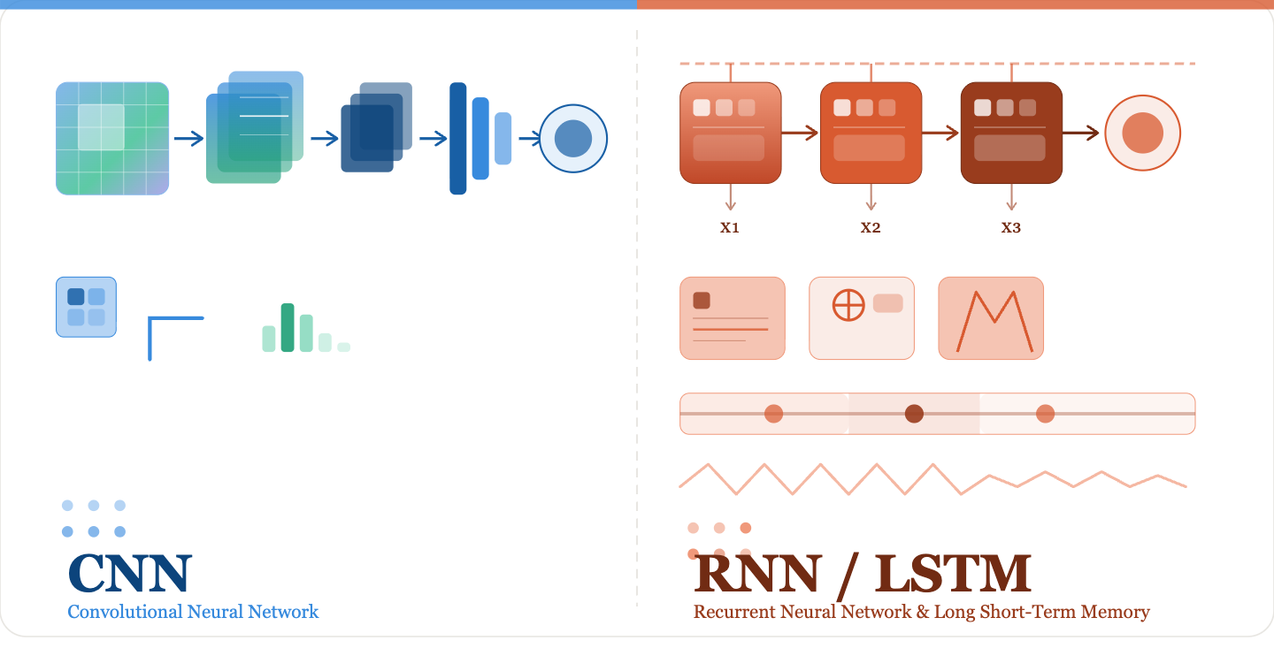
This lecture continues with CNN below. RNN/LSTM and Transformer architectures are covered in an upcoming session.
38

Slide 39
Convolutional Neural Networks (CNNs)
◈
Definition
Local Connectivity
Neurons connect to small regions, not the entire input
A Convolutional Neural Network (CNN) is a specialized deep learning architecture designed to process grid-structured data — primarily images.
Inspired by the visual cortex, CNNs use learnable filters that slide over input data to detect spatial patterns like edges, textures, and shapes.
They achieve translation invariance, meaning a learned feature can be detected regardless of where it appears in the image.
◉
Shared Weights
Same filter applied across all spatial locations
◆
Spatial Hierarchy
Low-level → high-level features through stacked layers
Originally proposed by LeCun et al. (1989) for digit recognition.
39

Slide 40
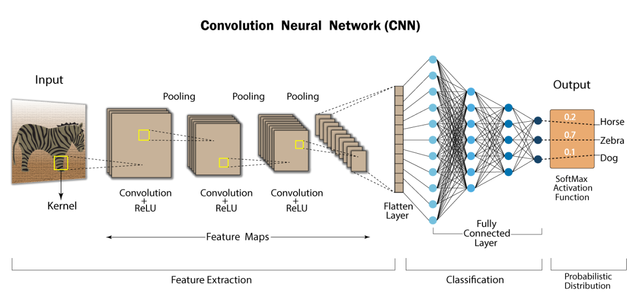
Convolutional Neural Networks (CNNs)
Convolution: Slide a small filter (kernel) over image to detect local features (edges, textures, patterns)
Parameter sharing: Same filter weights reused across all spatial locations → fewer parameters
Pooling: Downsample feature maps (MaxPool, AvgPool) → spatial invariance
Stacking layers: Low-level (edges) → Mid-level (shapes) → High-level (object parts) → Class
AlexNet (2012) — revolutionized image recognition; ResNet, VGG, EfficientNet followed
40

Slide 41
CNN Architecture
Input
Image
Conv
Layer
ReLU
Activ.
Pooling
Layer
Conv
Layer
Flatten
Fully
Connected
Softmax
Output
▶
▶
▶
▶
▶
▶
▶
Raw pixels
224×224×3
Detects local
features
Adds non-
linearity
Downsamples
feature maps
Learns deeper
features
Reshapes to
1D vector
Dense layer:
classifies
Outputs class
probabilities
Feature Map Depth Increases → Spatial Size Decreases →
Early Layers
Mid Layers
Deep Layers
Detect edges & simple patterns
Textures, shapes, object parts
High-level semantic concepts
41

Slide 42
Key CNN Components
⊞ Convolutional Layer
⚡ Activation (ReLU)
Applies learnable filters (kernels) via dot product
Produces feature maps capturing spatial patterns
Parameters: kernel size, stride, padding, # filters
Introduces non-linearity: f(x) = max(0, x)
Prevents vanishing gradient problem
Variants: Leaky ReLU, ELU, GELU
⊟ Pooling Layer
◎ Fully Connected Layer
Reduces spatial dimensions (downsampling)
Max pooling takes the maximum value in region
Provides translation invariance, reduces parameters
Combines all spatial features into a vector
Performs final classification/regression
Often uses Dropout for regularization
42

Slide 43
Convolution: Matrix Operation
Input image (5×5)
Filter / kernel (3×3)
Feature map (3×3)
1
2
3
0
1
-1
0
1
7
0
-6
0
1
2
3
0
-2
0
2
3
1
-2
1
3
2
1
2
×
-1
0
1
→
1
4
-2
2
0
1
3
1
0
1
2
1
0
Dot product — highlighted patch × kernel:
(1×-1) + (2×0) + (3×1) + (0×-2) + (1×0) + (2×2) + (1×-1) + (3×0) + (2×1) = 7
The filter slides across every 3×3 patch (stride = 1). Each position produces one value via element-wise multiply & sum → builds the full feature map.
43

Slide 44
Pooling Layer — Matrix Example
Input feature map (4×4)
Max-pooled output (2×2)
12
20
8
4
36
14
18
36
14
6
Max Pool
(2×2, stride 2)
11
30
5
11
22
30
→
2
7
17
25
Window colour key + How Max Pooling works:
TL → max = 36
TR → max = 14
BL → max = 11
BR → max = 30
Each 2×2 window slides with stride 2 — max value per window fills one output cell → 4×4 becomes 2×2.
44

Slide 45
Fully Connected Layer — Matrix Example
Step 1 — Flatten pooled feature map into a vector
36
22
→
flatten
36
22
30
25
30
25
x (1×4 input vector)
Step 2 — Multiply by weight matrix W (3×4) → scores for 3 classes
0.2
-0.1
0.4
0.1
36
19.5
Cat
100.0%
Cat
-0.3
0.5
0.1
-0.2
×
22
=
-1.8
Dog
→ Softmax →
probabilities
0.0%
Dog
W
30
0.1
0.2
-0.3
0.5
11.5
Bird
0.0%
Bird
(3×4)
25
scores
(3×1)
x
(4×1)
How the Fully Connected layer works:
The flattened vector x is multiplied by weight matrix W: score = W·x + b. Each row of W learns which combination of features predicts a class. Softmax then converts raw scores into probabilities that sum to 1.
45

Slide 46
Scikit learn → PyTorch
Why we make the move — and what changes
⚙️ Fixed vs. Flexible Pipelines
🧠 Shallow vs. Deep Models
⚡ CPU-only vs. GPU Acceleration
sklearn wraps algorithms in rigid fit/predict APIs. PyTorch lets you define any forward pass — custom loops, dynamic graphs, research ideas.
sklearn excels at classical ML (SVMs, trees, linear models). Deep networks — CNNs, RNNs, Transformers — need PyTorch's layer-level control.
sklearn runs on CPU. PyTorch moves tensors to GPU with .to('cuda'), enabling 10–100× speedups on large datasets and models.
🔁 Manual vs. Autograd
🔬 Black-box vs. Full Transparency
🌍 Local Tools vs. Industry Standard
In sklearn, gradients don't exist. PyTorch's autograd engine computes them automatically — essential for training any neural network.
sklearn hides internals. PyTorch exposes every weight, activation, and loss — you control and inspect everything for research & debugging.
PyTorch powers research at Meta, Google, Tesla & top universities. Moving to PyTorch means speaking the language of modern deep learning.
Bottom line: sklearn is a great starting point. But deep learning at scale demands the flexibility, power, and ecosystem that only PyTorch delivers.
46

Slide 47
PyTorch
Deep Learning in Python
Neural Network Building Blocks
Autograd & Optimization
torch.nn.Module, Linear, Conv2d, RNN/LSTM/GRU, Transformer — composable layers with autograd support
Automatic differentiation via torch.autograd · SGD, Adam, AdamW, RMSProp · Learning rate schedulers
Data Loading & Preprocessing
Key Design Principles
Dataset, DataLoader, torchvision.transforms · Batching, shuffling, augmentation · Custom Dataset API
Dynamic computation graph · Pythonic & debuggable · NumPy-compatible tensors · GPU/CPU seamless switching
Model Training & Evaluation
Ecosystem & Use Cases
Training loops, loss functions (CrossEntropy, MSE, NLL) · Checkpointing · TorchScript & ONNX export
torchvision, torchaudio, torchtext · Hugging Face integration · Used in CV, NLP, RL, generative AI
47
Notes:
torch.autograd is PyTorch's automatic differentiation engine — the machinery that computes gradients for you, which is what makes training neural networks with backpropagation practical without hand-deriving derivatives for every operation.
Here's the core idea: when you create a tensor with requires_grad=True, PyTorch starts tracking every operation performed on it. As you run your forward pass — matrix multiplies, activations, losses, whatever — PyTorch builds a computation graph behind the scenes, recording each operation and how it connects to the ones before it. This graph is dynamic, built on the fly each time you run the forward pass (this is PyTorch's "define-by-run" style, as opposed to older static-graph frameworks).
Once you have a scalar output (typically your loss), calling .backward() on it triggers autograd to walk the graph backward from that output to every tensor that had requires_grad=True. At each step it applies the chain rule, using each operation's known local derivative, and accumulates the result into that tensor's .grad attribute. So if you write loss.backward(), PyTorch automatically computes ∂loss/∂w for every parameter w in your model — this is exactly what feeds into the update rules we discussed earlier for Adam: it needs those gradients g_t to compute m_t and v_t.
A few practical details worth knowing: gradients accumulate by default, so you typically call optimizer.zero_grad() before each backward() call to avoid mixing gradients from different batches. Autograd tracks operations via a "tape" of Function objects (each op knows how to compute both its forward result and its backward/gradient rule), and once .backward() runs, that graph is freed by default unless you pass retain_graph=True. You can also temporarily disable tracking with torch.no_grad() when you don't need gradients, such as during evaluation or inference — this saves memory and computation.
In short: autograd is what turns "define a forward computation" into "get gradients for free," and it's the piece that connects your model architecture to the optimizers (SGD, Adam, AdamW, RMSProp) — those optimizers just consume the .grad values that autograd computed and use them to update parameters, exactly as in the update rule θ_t = θ_{t-1} − η·m̂_t/(√v̂_t + ε) from the Adam slide.

Slide 48
CNN in PyTorch
import torch # Core PyTorch library
import torch.nn as nn # Neural network module
class SimpleCNN(nn.Module): # Define a simple CNN model
def __init__(self):
super().__init__()
# First convolution layer:
self.conv1 = nn.Conv2d(1, 16, kernel_size=3, padding=1) #Input: 1 channel (grayscale), Output: 16 feature maps and kernel size = 3x3, padding=1 keeps spatial size same
# Second convolution layer
self.conv2 = nn.Conv2d(16, 32, kernel_size=3, padding=1) # Input: 16 channels → Output: 32 feature maps
# MaxPooling layer
self.pool = nn.MaxPool2d(2, 2) # Reduces spatial dimensions by half (e.g., 28x28 → 14x14)
# Activation function
self.relu = nn.ReLU()
# Fully connected layer:
# After two poolings: 28 → 14 → 7
# Final feature map size = 32 × 7 × 7
self.fc = nn.Linear(32 * 7 * 7, 10) # 10 output classes
nn.Conv2d(in, out, k)
Learnable 2D filters. Params: in/out channels, kernel_size, padding.
nn.MaxPool2d(2, 2)
Takes max over 2×2 windows — halves H and W.
nn.ReLU()
f(x) = max(0, x). Applied after every conv layer.
Input
Image
Conv
Layer
ReLU
Activ.
Pooling
Layer
Conv
Layer
Flatten
Fully
Connected
Softmax
Output
▶
▶
▶
▶
▶
▶
▶
nn.Linear(in, out)
Raw pixels
224×224×3
Detects local
features
Adds non-
linearity
Downsamples
feature maps
Learns deeper
features
Reshapes to
1D vector
Dense layer:
classifies
Outputs class
probabilities
Flattened features → class scores.
48
Notes:
First conv layer (self.conv1): nn.Conv2d(1, 16, kernel_size=3, padding=1) uses 16 filters. Each filter is 3×3 in spatial size and spans 1 input channel (since the input is grayscale, matching what we discussed earlier — a filter's depth always equals the input's channel count). So this layer takes a 1-channel image and produces 16 separate feature maps, one per filter — exactly the "stacking feature maps along a new depth dimension" idea from before.
Second conv layer (self.conv2): nn.Conv2d(16, 32, kernel_size=3, padding=1) uses 32 filters. This time each filter is 3×3×16 — it has to span all 16 channels coming in from the previous layer, not just a single channel, because (as we covered) once you have a multi-channel volume, each filter in the next layer extends across the full depth. The result is 32 output feature maps.
So the filter count doubles at each stage: 16 → 32. The other components in this network — MaxPool2d, ReLU, and the final Linear layer — aren't convolutional filters at all, so they don't have a "number of filters" in the same sense: pooling just downsamples spatially (28×28 → 14×14 → 7×7 after two poolings), ReLU is a pointwise nonlinearity, and the fully connected layer at the end flattens the final 32×7×7 volume into a vector and maps it to 10 output class scores.

Slide 49
SimpleCNN — Forward Pass
Block 1 · x = self.pool(self.relu(self.conv1(x)))
forward(self, x)
Input
Conv2d
ReLU
MaxPool2d
# Block 1
1 ch · grayscale
1→16 ch
3×3 pad=1
non-linear
2×2 stride 2
28→14
x = self.pool(
1×28×28
16×28×28
16×28×28
16×14×14
self.relu(
self.conv1(x)))
Block 2 · x = self.pool(self.relu(self.conv2(x)))
# Block 2
Conv2d
ReLU
MaxPool2d
Flatten
x = self.pool(
self.relu(
16→32 ch
3×3 pad=1
non-linear
2×2 stride 2
14→7
x.view(-1)
32×7×7=1568
self.conv2(x)))
32×14×14
32×14×14
32×7×7
1568
# Flatten
x = x.view(
x.size(0), -1)
Linear (FC)
Output
self.fc(x) · 1568→10
10 class scores
# Output
10 logits
logits
return self.fc(x)
49
Conv
ReLU
Pool
Flatten
FC
Deep Learning · IIT Kharagpur
Output

Slide 50
CNN Applications & Famous Architectures
Computer Vision
Medical Imaging
Other Domains
Image Classification
Object Detection (YOLO)
Semantic Segmentation
Facial Recognition
Tumor Detection in MRI
Diabetic Retinopathy
Histopathology Analysis
COVID-19 CT Screening
NLP (Text-CNN)
Audio Classification
Video Understanding
Autonomous Driving
Landmark CNN Architectures
LeNet
AlexNet
VGGNet
ResNet
EfficientNet
1989
2012
2014
2015
2019
50

Slide 51
CNNs & Long-Range Dependencies
1 → 1000
Word 1 must inform word 1000 — theoretically reachable, practically hard
word positions a CNN must bridge, layer by layer
A
CNNs cannot process sequences
✗
B
Info must travel through many layers
✓
False — 1D convolutions handle sequences routinely (text, audio). Sequence support isn't the issue.
Correct — local receptive fields mean distant positions connect only via deep stacks; signal is harder to learn and represent over many hops.
C
CNNs cannot use gradient descent
✗
D
CNNs require one-hot encodings
✗
False — CNNs are trained by ordinary backprop and gradient descent, same as any differentiable network.
False — input representation is flexible: embeddings, raw pixels, etc. Not a CNN requirement.
53

Slide 52
Drawbacks of CNN
CNNs are designed to process fixed-size input images and generate fixed-size outputs. They struggle with variable-length sequences, such as sentences in natural language processing (NLP) or varying-length videos.
CNNs process data points independently or within a small local window. They cannot inherently capture the temporal relationship or context across time steps, making them inefficient for tasks where order matters, like stock forecasting or text generation.
54

Slide 53
Convolutional Neural Networks (CNNs)
Convolution: Slide a small filter (kernel) over image to detect local features (edges, textures, patterns)
Parameter sharing: Same filter weights reused across all spatial locations → fewer parameters
Pooling: Downsample feature maps (MaxPool, AvgPool) → spatial invariance
Stacking layers: Low-level (edges) → Mid-level (shapes) → High-level (object parts) → Class
AlexNet (2012) — revolutionized image recognition; ResNet, VGG, EfficientNet followed
55

Slide 54
Feature Learning through Embeddings
A motivating journey: from hand-crafted statistics to learned dense vectors
How do we turn raw text into something a machine can learn from?
📄
🔢
🧠
Raw Text
Representation
ML Model
"The cat sat on the mat"
Vectors, numbers, tensors
Classification, generation…
The representation step is the key bottleneck — and the biggest opportunity.
56

Slide 55
One-Hot Vector Representation
Vocabulary (|V| = 8)
Step 1: Assign every word a unique index in a fixed vocabulary
0
1
2
3
4
5
6
7
cat
dog
king
queen
apple
runs
happy
the
cat
1
0
0
0
0
0
0
0
← 8-dim vector, exactly one '1'
king
0
0
1
0
0
0
0
0
← 8-dim vector, exactly one '1'
queen
0
0
0
1
0
0
0
0
← 8-dim vector, exactly one '1'
Key property: Each word is a point in high-dimensional space. The '1' is at index i, everything else is 0.
57

Slide 56
Classification with One-Hot Vectors
Example: sentiment classification — can a linear model separate positive from negative?
Bag-of-Words Representation
POSITIVE
"The cat is happy"
→ [1, 0, 0, 0, 0, 0, 1, 1]
😊 +1
Linear
Classifier
😞 −1
NEGATIVE
"The dog runs away"
w · x + b
→ [1, 0, 1, 1, 1, 0, 0, 0]
How the vectors are built
Vocab (idx 0–7): the, sad, dog, runs, away, boring, cat, happy
“The cat is happy” → the,cat,happy (idx 0,6,7) → [1,0,0,0,0,0,1,1]
“The dog runs away” → the,dog,runs,away (idx 0,2,3,4) → [1,0,1,1,1,0,0,0]
Sparse vector: mostly 0s — real vocabs have 20,000+ words
“happy”/“joyful” = separate axes → orthogonal, look unrelated
✅ What works
⚠️ What struggles
• Simple, fast, interpretable weights
• Works for word-frequency signals
• "happy" and "joyful" treated as unrelated
• Sparse vectors → huge, mostly-zero inputs
58
Notes:
How the one-hot / bag-of-words vectors are built
The two sentences share one fixed 8-word vocabulary, indexed 0–7: 0=the, 1=sad, 2=dog, 3=runs, 4=away, 5=boring, 6=cat, 7=happy. “Sad” and “boring” aren’t in either sentence — they’re just other words from the training vocabulary, included to show that most slots stay at 0.
For each sentence, put a 1 at the index of every vocabulary word it contains, and 0 everywhere else (word order doesn’t matter — that’s why it's called a “bag” of words). Function words like “is” are typically dropped as stopwords before counting, since they carry little meaning.
“The cat is happy” → contains the(0), cat(6), happy(7); “is” is dropped as a stopword → [1,0,0,0,0,0,1,1].
“The dog runs away” → contains the(0), dog(2), runs(3), away(4) → [1,0,1,1,1,0,0,0].
What is a sparse vector?
A sparse vector is one where almost all entries are 0, with only a few nonzero. These two examples look fairly “full” because the vocabulary is tiny (8 words), but a real bag-of-words vocabulary has tens of thousands of words — so a normal sentence (maybe 10–20 words) still only lights up 10–20 indices out of 20,000+. That's what “sparse” means: huge vectors that are almost entirely zero, which wastes memory and computation and gives the model very little to generalize from.
Why are “happy” and “joyful” treated as unrelated?
Every word gets its own independent axis/index, assigned arbitrarily (alphabetically, or by order of appearance) — there's no notion of meaning behind the assignment. “Happy” being at index 7 and “joyful” being at, say, index 42 is purely coincidental bookkeeping. Their one-hot vectors are orthogonal (dot product = 0) and have the same Euclidean distance apart as “happy” and any totally unrelated word like “table”. The model only ever sees whether a word is present in a sentence, never how it relates to other words — so two synonyms that never happen to appear in the exact same training sentences look exactly as unrelated to the model as two random words. This blind spot is exactly what motivates learned word embeddings (coming up next), where similar words end up close together in vector space instead of on arbitrary, unrelated axes.

Slide 57
One-Hot Vectors
Where every NLP pipeline once began
59

Slide 58
One-Hot Encoding
Python
⚡ Sparse & Huge
from sklearn.preprocessing import OneHotEncoder
import numpy as np
vocab = ["king", "queen", "man", "woman", "cat"]
# Vocab size = 50,000 in production!
encoder = OneHotEncoder(sparse_output=False)
vectors = encoder.fit_transform([[w] for w in vocab])
print(vectors.shape) # (5, 5) → (50000, 50000) in prod
# king = [1, 0, 0, 0, 0]
# queen = [0, 1, 0, 0, 0]
# man = [0, 0, 1, 0, 0]
# Cosine similarity?
from numpy.linalg import norm
cos = lambda a,b: np.dot(a,b)/(norm(a)*norm(b))
print(cos(vectors[0], vectors[1])) # 0.0 ← king ≠ queen??
50K vocab → 50K-dim vector. 2.5GB matrix. Most values are 0.
🧠 No Semantics
cos(king, queen) = 0.0. The model has no idea they're related.
🔗 No Relationships
king − man + woman = ??? The math is meaningless.
→ We need dense, meaningful representations.
60
Notes:
Speaker Note:
This slide introduces one-hot encoding — the simplest way to represent words as numbers that a machine can process.
We start with a small vocabulary of five words: king, queen, man, woman, and cat. In practice, a real NLP vocabulary like GPT's contains around 50,000 such words.
Using sklearn's OneHotEncoder, each word gets converted into a vector that is all zeros except for a single 1 at the position corresponding to that word. So "king" becomes [1,0,0,0,0], "queen" becomes [0,1,0,0,0], and so on. The position of the 1 is the word's identity — nothing more.
The shape of our output matrix is 5×5 here, but in production with 50,000 words, this explodes to a 50,000×50,000 matrix — that's 2.5 billion values, almost all of them zero. This is called a sparse, high-dimensional representation, and it's deeply inefficient.
Now here's the critical problem this slide is pointing to. When we compute cosine similarity between "king" and "queen" — two words that are semantically very close — we get 0.0. That's because their one-hot vectors are perfectly perpendicular; they share no common dimensions at all. One-hot encoding treats every word as equally distant from every other word. It captures absolutely no semantic relationship.
This is the fundamental limitation that motivates word embeddings — a dense, low-dimensional representation where "king" and "queen" actually end up geometrically close to each other.

Slide 59
The Search Engine Synonym Problem
📋 Scenario: A search engine observes that users who search "car" often click the same pages as users who search "automobile".
🔍 Observation: Despite identical intent, the system returns different results — it treats the two words as completely unrelated.
❓ Question: As an engineer, which approach do you choose to fix this?
A
One-hot representations + cosine similarity
B
Hardcoded synonym table (car ↔ automobile)
C
PCA on one-hot vectors
D
None of the above
65

Slide 60
Option A — One-Hot Vectors + Cosine Similarity
Representation
What Goes Wrong?
car → [1, 0, 0, 0, 0, ...]
cos(car, automobile) = 0
cos(car, banana) =
0
automobile → [0, 1, 0, 0, 0, ...]
banana → [0, 0, 1, 0, 0, ...]
❌ Verdict
"car" and "automobile" are no closer than "car" and "banana". Click behavior is completely ignored.
Answer A is ❌ Wrong
66

Slide 61
Option C — PCA on One-Hot Vectors
PCA Doesn't Discover Meaning
It only reflects the structure that's already in the data
One-Hot Input → PCA Output
Trained Embeddings → PCA Output
car
chair
bus
car
banana
bus
apple
cloud
banana
auto
mango
apple
Still symmetric — no clusters, no meaning recovered
Real clusters survive — meaning was already encoded
PCA is a mirror, not a mind reader — it can only compress meaning that was already learned, never invent it.
67

Slide 62
Option B — Hardcoded Synonym Table
✅ Pros
❌ Cons
• Fixes the observed problem immediately
• Does not scale — manual maintenance
• Easy to implement and deploy
• Misses context-dependent synonyms
• Widely used in commercial search engines
• Cannot discover new relationships automatically
• No training data required
• Brittle — one engineer's judgment
⚠️ Context matters!
In a practical engineering interview: B is a reasonable pragmatic answer.
In an ML/representation-learning exam: D (dense embeddings) is the intended answer.
68

Slide 63
Option D
Core Idea
Words that lead to similar user behavior should have similar vector representations.
❌ One-Hot Space
✅ Dense Embedding Space
car → [1, 0, 0, 0, 0, ...]
car → [0.21, -0.37, 0.88, ...]
automobile → [0, 1, 0, 0, 0, ...]
automobile → [0.19, -0.35, 0.85, ...]
cos similarity = 0
cos similarity ≈ 0.99 🎯
How to learn these embeddings:
Word2Vec / GloVe on text corpora
Query-document click graphs
Neural retrieval models (DPR, BERT)
69

Slide 64
Limitations of Sparse Representations
🔤 No Semantic Meaning
📏 Curse of Dimensionality
"king" and "queen" are two unrelated dimensions — dot product = 0
"cat" ≠ "kitten" in TF-IDF
Vocabulary of 100k words = 100k-dim vectors with 99%+ zeros
99%+ entries are zero
🔀 No Word Order
🆕 Out-of-Vocabulary
"dog bites man" and "man bites dog" have identical representations
Bag-of-words assumption
New words at test time have no vector — model is completely blind
Zero vector = no info
→ These are fundamental flaws. We need a smarter representation.
70

Slide 65
Why Sparsity Breaks Similarity
The dot product between any two one-hot vectors is always zero
Cosine Similarity between one-hot vectors:
cat
1
0
0
0
0
0
0
0
·
kitten
0
0
0
0
1
0
0
0
=
0.00
synonyms!
king
0
0
1
0
0
0
0
0
·
queen
0
0
0
1
0
0
0
0
=
0.00
antonyms?
happy
0
0
0
0
0
0
1
0
·
dog
0
1
0
0
0
0
0
0
=
0.00
unrelated!
💡 Insight
One-hot vectors are orthogonal by construction — the model can never discover that "cat" and "kitten" are related.
We need a representation where similar words are geometrically close.
71

Slide 66
Distributional Semantics — Words by Context
"You shall know a word by the company it keeps" — J. R. Firth, 1957
The Big Idea
Context Window (k = 2)
① A word's meaning is defined by the words that frequently appear around it.
…government debt problems turning into banking crises as happened in 2009…
② Context window: look at ±k words on either side of the target word.
…saying that Europe needs unified banking regulation to replace the hodgepodge…
③ Build a vector from the distribution of context words across a large corpus.
…India has just given its banking system a shot in the arm…
④ Similar contexts → similar meaning → similar vectors.
These context words will represent banking
💡 Key shift:
Instead of a word's position in a fixed vocabulary, we encode what words it co-occurs with.
Count co-occurrences → compress → dense vector. This is the road to word embeddings.
72

Slide 67
Dense Representations — Distributed Semantics
Replace one sparse index with a short, dense vector where every dimension carries meaning
SPARSE (One-Hot)
DENSE (Word Embedding)
0
0
1
0
0
0
0
0
0
0
0
0
0.32
-0.71
0.15
0.88
-0.43
0.07
0.61
-0.22
… (50,000 dims)
(300 dims — every value carries meaning)
✗ 99%+ zeros
learn
weights
✓ All values active
✗ No similarity
✓ Geometry = meaning
✗ Huge memory
✓ Compact & fast
Geometry encodes meaning — famous examples:
How this works: no one hand-designs this arithmetic — training makes recurring relationships (gender, capital-of) become consistent offset directions in the space.
So vec(king) + [vec(woman) − vec(man)] ≈ vec(queen), and vec(Paris) + [vec(Germany) − vec(France)] ≈ vec(Berlin); the nearest real word (by cosine similarity) is read off as the answer.
vec("king") − vec("man") + vec("woman")
≈ vec("queen")
vec("Paris") − vec("France") + vec("Germany")
≈ vec("Berlin")
cosine( vec("cat"), vec("kitten") )
≈ 0.92 ✓
73
Notes:
How the king − man + woman ≈ queen arithmetic is derived
vec(“word”) means the learned embedding vector for that word — a point in the dense space discussed earlier on this slide (e.g. the 300-dim vector). These vectors are NOT hand-built to satisfy this arithmetic; the arithmetic is an emergent property that shows up after training.
During training (skip-gram / CBOW, as covered for context windows), a word's vector is pulled toward whatever lets the model predict its neighbors well. If a relationship recurs across many word pairs in the corpus — “man is to woman” the same way “king is to queen”, or “France is to Paris” the same way “Germany is to Berlin” — the model ends up placing those pairs so that the offset (difference vector) between them points in roughly the same direction and has roughly the same length, for every pair sharing that relationship.
Gender example, rearranged algebraically:
vec(king) − vec(man) + vec(woman) = vec(king) + [vec(woman) − vec(man)]. The bracketed term [vec(woman) − vec(man)] is the “male → female” offset direction, learned from many such male/female word pairs. Adding that same offset to vec(king) moves it to roughly where a “female royal” word would sit — which is where vec(queen) happens to be. The result is a new point in the space, not an existing word; we then search for the real word vector closest to it (by cosine similarity), and that nearest neighbor is “queen”.
Capital-of example, same logic:
vec(Paris) − vec(France) + vec(Germany) = vec(Paris) + [vec(Germany) − vec(France)]. Here [vec(Germany) − vec(France)] is a “country identity” shift. Since Paris and Berlin both hold the same relation to their country (“capital of”), shifting Paris by the France→Germany offset lands near Berlin, and Berlin is the nearest real word vector to that point.
Why this works — and where it doesn't
This only emerges reliably when the embeddings are trained on a huge corpus, so the same relationship is reinforced across thousands of examples (many gender pairs, many country/capital pairs); it was first popularized by the word2vec paper (Mikolov et al., 2013). The ≈ matters — the arithmetic gives an approximate point, found by nearest-neighbor search, and it works best for clean, frequent, systematic relationships. Rarer or noisier relationships, or words with few training examples, often break the pattern.

Slide 68
Feature Learning through Embeddings
The embedding model learns dense vectors from raw data — no hand-crafting required.
Any Objects
Dense Vector Space
📝 word: "cat"
Embedding
Model
king
prince
📄 sentence
cat
kitten
queen
royalty
dog
animals
happy
sad
(Word2Vec, GloVe,
BERT, GPT…)
🖼️ image
Paris
Tokyo
joyful
emotion
Berlin
places
👤 user profile
Embeddings !! — Dense, low-dimensional vectors where geometry encodes linguistic meaning.
74

Slide 69
Dense Embeddings
Compact, learned vector representations
75

Slide 70
Embedding Lookup Tables
PyTorch
What changed?
import torch
import torch.nn as nn
VOCAB_SIZE = 50_000
EMBED_DIM = 300 # was 50K, now just 300!
# This is a learnable weight matrix: (50000, 300)
embedding = nn.Embedding(VOCAB_SIZE, EMBED_DIM)
# Forward pass: integer index → dense vector
token_ids = torch.tensor([42, 1337, 7]) # vocab IDs: "king", "queen", "man"
vectors = embedding(token_ids) # shape: (3, 300)
# During training, gradients flow back and update weights
# Similar words end up with similar vectors — automatically!
optimizer = torch.optim.Adam(embedding.parameters())
print(vectors.shape) # torch.Size([3, 300])
# → 3 tokens, each a 300-dim vector
print(f"Memory: {VOCAB_SIZE * EMBED_DIM * 4 / 1e6:.1f} MB")
# (VOCAB_SIZE × EMBED_DIM) × 4 bytes ÷ 1e6
# = size in MB; :.1f → 1 decimal place
# Memory: 60.0 MB vs 10 GB for one-hot!
50K dims
→
300 dims
✓ 167× smaller
All zeros
→
Dense floats
✓ Information-rich
Fixed
→
Learned
✓ Task-aware
76

Slide 71
Word2Vec: Two Training Strategies
Skip-gram
CBOW
Input: center word → Predict: context words
Input: context words → Predict: center word
"The [cat] sat on the mat"
↓
Predict: "The", "sat", "on"
"The [?] sat on the mat"
↑
Context: "The", "sat", "on"
Better for rare words
Faster, good for frequent words
Gensim
model = Word2Vec(sentences, vector_size=100,
window=3, min_count=1,
sg=1) # sg=1: Skip-gram, sg=0: CBOW
# The famous analogy
# king+woman−man → nearest by cosine sim
result = model.wv.most_similar(
positive=["king","woman"], negative=["man"])
print(result[0]) # ('queen', 0.9991...)
from gensim.models import Word2Vec # Gensim: implements Word2Vec
# training corpus: each inner list = one tokenized sentence
sentences = [["king","rules","the","kingdom"],
["queen","rules","the","kingdom"],
["man","is","a","human"],["woman","is","a","human"]]
78
Notes:
What is Gensim?
Gensim is an open-source Python package developed by Radim Řehůřek.
It is designed for
Word2Vec
Doc2Vec
FastText
Topic Modeling (LDA, LSI)
Similarity Search
Text preprocessing
What is Word2Vec?
Word2Vec (Mikolov et al., 2013) is a neural-network technique that learns a dense vector for every word by training a shallow network on a large text corpus. Words that tend to appear in similar contexts end up with similar vectors — this slide's two cards are its two ways of setting up that training.
Skip-gram vs. CBOW
Skip-gram: the model takes ONE center word as input and tries to predict the words around it (its context). Each occurrence of a word yields several training examples (one per context word), which is why it learns rare words well.
CBOW (Continuous Bag of Words): the model takes the surrounding CONTEXT words as input and tries to predict the single center word. Context words are averaged into one signal, so training is faster — good when frequent words dominate the corpus.
Walking through the Gensim code
from gensim.models import Word2Vec: brings in Gensim's Word2Vec class — Gensim is the Python library used here to actually train the model (see “What is Gensim?” above).
sentences = [[...], [...], ...]: the training corpus. Each inner list is one already-tokenized sentence (a list of word strings); Word2Vec learns from co-occurrence patterns across all of these sentences.
model = Word2Vec(sentences, vector_size=100, window=3, min_count=1, sg=1): trains the model. vector_size=100 sets each word's embedding to 100 dimensions; window=3 sets the context radius (±3 words on each side); min_count=1 keeps every word that appears at least once (normally set higher to drop rare noise); sg=1 selects Skip-gram (sg=0 would select CBOW).
result = model.wv.most_similar(positive=[“king”,“woman”], negative=[“man”]): the same king − man + woman ≈ queen analogy explained on the “Dense Representations” slide. positive=[...] lists vectors to ADD, negative=[...] lists vectors to SUBTRACT; Gensim adds/subtracts those word vectors and returns the words whose vectors are nearest (by cosine similarity) to the result, ranked most-similar first.
print(result[0]): result is a ranked list of (word, similarity_score) tuples; result[0] is the closest match — here, on a real-scale corpus, that would be (‘queen’, 0.9991…). On this toy 4-sentence corpus the model hasn't actually seen enough data to learn that relationship well; the output in the comment shows what a properly-trained model would return.

Slide 72
Word2Vec
Skip-gram & CBOW — learning from context
77

Slide 73
Static Embeddings Can't Handle Polysemy
PyTorch
"bank" in Word2Vec
# Word2Vec gives ONE vector per word, regardless of context
model = Word2Vec.load("word2vec-google-news-300")
bank_vector = model.wv["bank"] # One single vector
# But "bank" means DIFFERENT things:
# "I deposited money at the bank" → financial institution
# "She sat on the river bank" → geographic feature
# "The plane had to bank left" → aeronautical maneuver
# Word2Vec collapses all meanings into ONE point in space!
print(model.wv.most_similar("bank"))
# [('banks', 0.92), ('banking', 0.89), ('financial', 0.85), ...]
# No context. No disambiguation. Just one averaged vector.
bank
(1 vector)
💰 finance?
🌊 river?
✈️ plane?
💡 Fix: Embeddings should be computed dynamically based on the surrounding context.
81

Slide 74
From Perceptron to Specialized Architectures
1958
1980s
1990s
1990s
2017–now
Perceptron
MLP
CNN
RNN / LSTM
Transformer
x1
x2
x3
Head 1
Σ
h
h
h
Head 2
Head 3
conv
pool
FC
Multi-Head Attention
Single neuron
Binary output
Linear boundary
Step activation
Hidden layers
Backpropagation
Non-linear fn
Universal approx
Conv filters
Spatial hierarchy
Weight sharing
Image/vision tasks
Sequential data
Hidden state
Long-term memory
NLP / time-series
Self-attention
Parallelizable
Positional enc.
LLMs / GPT / BERT
Deep Learning · IIT Kharagpur
82
Complexity & Specialization →

Slide 75
Recap
Network Setup
01
02
03
04
05
tune
fast_forward
calculate
fast_rewind
sync
Initialize Weights
Define input vector and target values to establish initial state.
Forward Pass
Propagate inputs through layers to compute activations and predictions.
Loss Compute
Calculate discrepancy between predicted output and target values.
Backward Propagation
Compute gradients of loss with respect to parameters via chain rule.
Weight Update
Adjust weights using calculated gradients and specified learning rate.
83

Slide 76
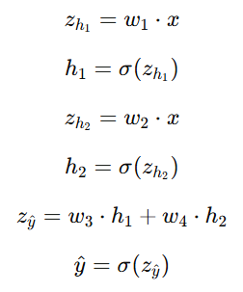

Network Setup
Initialize weights, define input and target
Initial parameters
h₁
w₁=0.6000
0.6457
w₃=0.8000
Input
x = 1.0
x
ŷ
target y=1
Target
y = 1.0
1.0
0.6934
w₂=0.4000
h₂
Learning rate
η = 0.5
h₂
w₄=0.5000
0.5987
0.5987
w₁
0.6000
Forward pass -
w₂
0.4000
w₃
0.8000
w₄
0.5000
84

Slide 77
Forward Pass — Step 1
Compute weighted sum z₁ and activation h₁
Hidden neuron 1
h₁
z₁ =
w₁ × x = 0.6 × 1.0
w₁=0.6000
0.6457
w₃=0.8000
x
ŷ
=
0.6000
target y=1
1.0
0.6934
w₂=0.4000
w₄=0.5000
h₁ =
σ(z₁) = 1 / (1 + e⁻⁰·⁶)
h₂
0.5987
Forward pass -
=
0.6457
z₁ (pre-activation)
h₁ = σ(z₁)
0.6000
0.6457
Sigmoid squashes z₁=0.6 → h₁=0.6457. Because z₁ > 0, h₁ > 0.5.
85

Slide 78
Forward Pass — Step 2
Compute weighted sum z₂ and activation h₂
Hidden neuron 2
h₁
z₂ =
w₂ × x = 0.4 × 1.0
0.6457
w₁=0.6000
w₃=0.8000
x
ŷ
=
0.4000
target y=1
1.0
0.6934
w₂=0.4000
w₄=0.5000
h₂
h₂ =
σ(z₂) = 1 / (1 + e⁻⁰·⁴)
0.5987
Forward pass -
=
0.5987
z₂ (pre-activation)
h₂ = σ(z₂)
0.4000
0.5987
h₂=0.5987 < h₁=0.6457 because w₂=0.4 < w₁=0.6 → smaller pre-activation.
86

Slide 79
Forward Pass — Step 3
Compute output z₃ and prediction ŷ
Output neuron
h₁
z₃ =
w₃×h₁ + w₄×h₂
0.6457
w₁=0.6000
w₃=0.8000
=
0.8 × 0.6457 + 0.5 × 0.5987
x
ŷ
target y=1
1.0
0.6934
=
0.5165 + 0.2993
w₂=0.4000
w₄=0.5000
h₂
=
0.8159
0.5987
Forward pass -
ŷ =
σ(0.8159)
=
0.6934
z₃
ŷ(predicted)
target y
0.8159
0.6934
1.0000
ŷ=0.6934 but target=1.0 — prediction is too low. Error = 0.3066.
87

Slide 80

Compute MSE Loss
How far is the prediction from the target?
Mean Squared Error
L =
½ × (y − ŷ)²
h₁
0.6457
=
½ × (1.0 − 0.6934)²
w₁=0.6000
w₃=0.8000
x
ŷ
target y=1
1.0
0.6934
=
½ × (0.3066)²
w₂=0.4000
w₄=0.5000
h₂
=
½ × 0.0940
0.5987
L =
0.0470
error (y−ŷ)
(y−ŷ)²
loss L
0.3066
0.0940
0.0470
The ½ cancels the 2 from differentiation. Loss ≥ 0 always; 0 = perfect.
88

Slide 81


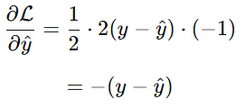

Objective— Weight update of w₃
Chain rule: how much should the output neuron change?
h₁
0.6457
w₃=0.8000
ŷ
target y=1
0.6934
w₄=0.5000
h₂
0.5987
89

Slide 82
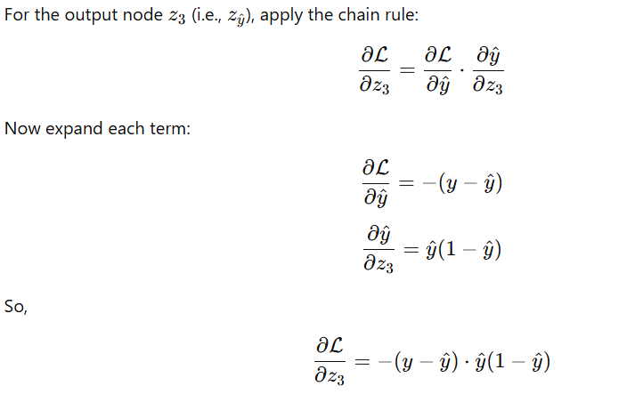
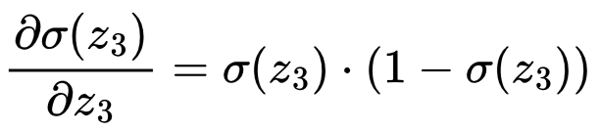
Backprop — Output Delta δ_out
Chain rule: how much should the output neuron change?
h₁
0.6457
w₃=0.8000
ŷ
target y=1
0.6934
w₄=0.5000
h₂
0.5987
90

Slide 83

Backprop — Output Delta δ_out
Chain rule: how much should the output neuron change?
Output error signal
σ′(z₃) =
ŷ × (1 − ŷ)
h₁
(δ_out)
0.6457
=
0.6934 × 0.3066
w₃=0.8000
ŷ
target y=1
=
0.2126
0.6934
w₄=0.5000
h₂
δ_out =
-(y − ŷ) × σ′(z₃)
0.5987
=
-0.3066 × 0.2126
=
-0.0652
σ′(z₃) — sensitivity
δ_out — error signal
0.2126
-0.0652
91

Slide 84


Update Output Weights w₃ and w₄
w ← w - η · δ_out · h
Output layer weight updates
h₁
w₃_new = w₃ - η × δ_out × h₁
0.6457
w₃=0.8210
= 0.8000 + 0.5 × 0.0652 × 0.6457
ŷ
target y=1
0.6934
= 0.8000 + 0.0210
w₄=0.5195
w₃_new = 0.8210
h₂
0.5987
w₃: 0.8000 → 0.8210
+0.0210
Larger h → larger weight change. h₁ > h₂ so Δw₃ > Δw₄.
92

Slide 85
After 1 Epoch
Before (epoch 0)
After (epoch 1)
Improvement
w₁
0.6000
w₁
0.6060
Loss drop
-3.5%
w₂
0.4000
w₂
0.4039
ŷ gain
+0.0053
w₃
0.8000
w₃
0.8210
Gap to 1.0
0.3013
w₄
0.5000
w₄
0.5195
Δw₃
+0.0210
ŷ
0.6934
ŷ
0.6987
Δw₄
+0.0195
Loss
0.0470
Loss
0.0454
Δw₁
+0.00597
Repeat: Forward → Compute Loss → Backprop δ → Update all weights — thousands of epochs until loss ≈ 0
93

Slide 86




Thank you
Instructor
Teaching Assistants (IITKGP)
Sombit Bose
Anurup Naskar
Shrimon
Mukherjee
Sabyasachi
Mukhopadhyay
94

